Slide 1
Perceptron
Chapter 02
zzp-coder

Slide 2
Content
Perceptron
Simple Logic Circuit
Implementation of Perceptron
Limitation of Perceptron
Multi-layers Perceptron

Slide 3
What is perceptron?
Perceptron have several signals as input(1 or 0) and one signal as output(1 or 0), 1 represent “convey signal”, 0 represent “not convey signal”
Perceptron with two inputs:
input1
x1
y
output
input2
x2

Slide 4
What is perceptron?
When neurons receive inputs, these inputs will times fixed weights
Neuron calculate the sum of inputs, when sum is larger than a certain number, it will output 1
input1
x1
w1
y
output
input2
x2
w2
Neuron/Node

Slide 5
What is perceptron?
The certain number named “threshold”, represented by θ
Represented with code:
If (w1*x1+w2*x2<= θ): y=0
Else: y=1
input1
x1
w1
y
output
input2
x2
w2
Neuron/Node

Slide 6
What is perceptron?
Weights control the Signal Flow Difficulty
Weight larger, signal flow easier, output signal larger
Weight smaller, signal flow more difficult, output signal smaller
input1
x1
w1
y
output
input2
x2
w2
Neuron/Node

Slide 7
Simple Logic Circuit
AND gate
Let us consider using Perceptron to solve a simple problem, take AND gate(with two inputs and one output) as an example.
We need to represent AND gate with a Perceptron, then what we need to find the parameter(w1, w2, θ) ​​that satisfy the above four conditions
x1 | x2 | y
0 | 0 | 0
1 | 0 | 0
0 | 1 | 0
1 | 1 | 1

Slide 8
Simple Logic Circuit
AND gate
0*w1+0*w2 <= θ
1*w1+0*w2 <= θ
0*w1+1*w2 <= θ
1*w1+1*w2 > θ
Actually, we have countless parameter choices that can satisfy these four conditions. (0.5, 0.5, 0.7),(1.0,1.0,1.0),….

Slide 9
Simple Logic Circuit
NAND gate (Not And)
Reverse the output of AND gate:
The combinations are infinite, and can be achieved by simply negating the parameter value of AND gate
x1 | x2 | y
0 | 0 | 1
1 | 0 | 1
0 | 1 | 1
1 | 1 | 0

Slide 10
Simple Logic Circuit
If we negating the parameter value of AND gate, we get:
-0*w1-0*w2 <= θ
-1*w1-0*w2 <= θ
-0*w1-1*w2 <= θ
-1*w1-1*w2 > θ
0*w1+0*w2 >= θ
1*w1+0*w2 >= θ
0*w1+1*w2 >= θ
1*w1+1*w2 < θ

Slide 11
Simple Logic Circuit
If we negating the parameter value of AND gate, we get:
-0*w1-0*w2 <= θ
-1*w1-0*w2 <= θ
-0*w1-1*w2 <= θ
-1*w1-1*w2 > θ
NAND gate
0*w1+0*w2 > θ
1*w1+0*w2 > θ
0*w1+1*w2 > θ
1*w1+1*w2 <= θ
0*w1+0*w2 >= θ
1*w1+0*w2 >= θ
0*w1+1*w2 >= θ
1*w1+1*w2 < θ
As long as the decision boundary is clear, it doesn’t matter where the boundary is defined.

Slide 12
Simple Logic Circuit
OR gate
Try to think what parameters we need to set to represent OR gate with perceptron?
x1 | x2 | y
0 | 0 | 0
1 | 0 | 1
0 | 1 | 1
1 | 1 | 1

Slide 13
Process of deciding perceptron parameters
We look truth table(training data), and consider parameters
The subject of machine learning(ML) is to let the computer automatically determine the parameters.
Learning is the process of determining parameters, what we need to do is to consider the structure of perceptron, and feed training data into computers.

Slide 14
Implementation of Perceptron
Considering further study, we change -θ with b, and modify the function into:
If w1*x1+w2*x2+b<=0, y=0
Else if w1*x1+w2*x2+b>0, y=1
b: bias
W1, w2: weights
We perform AND NAND OR gat with perceptron using NumPy:
Weights control the importance of input signals.
Bias adjust how easy the neural be activated.

Slide 15
Limitation of Perceptron
XOR gate
x1 | x2 | y
0 | 0 | 0
1 | 0 | 1
0 | 1 | 1
1 | 1 | 0
We can not represent XOR gate using perceptron we introduced before
Why?

Slide 16
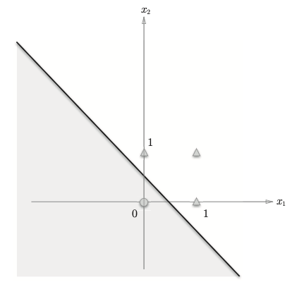
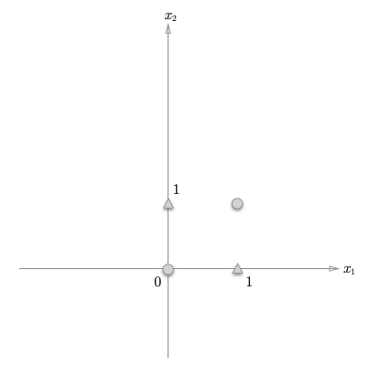
Limitation of Perceptron
Because Perceptron is Linear
OR gate
XOR gate

Slide 17
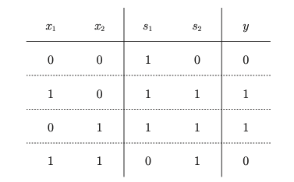
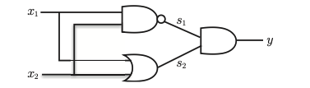
Multilayer Perceptron
Perceptrons can stack layers
NAND
AND
OR
Through stack NAND OR AND layer, we can get XOR

Slide 18
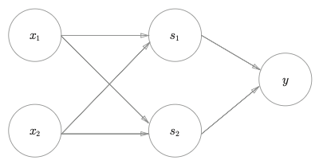
Multilayer Perceptron
XOR is a two-layer perceptron:
The perceptron can represent nonlinearity by stacking layers, and in theory can also represent computer.
Layer 0
Layer 1
Layer 2
Things that a single-layer perceptron cannot express can be solved by adding a layer

